Slide 1

The Ginkgo Sparse Linear Algebra Package
ICL Booth Talk
Supercomputing 2019
Hartwig Anzt

Slide 2









Overview
Open-source C++ framework for sparse linear algebra.
Sparse linear solvers, preconditioners, SpMV etc.
Generic algorithm implementation: + reference kernels for checking correctness; + architecture-specific highly optimized kernels.
Focused on Multicore and Manycore accelerators;
Software quality and sustainability efforts guided by xSDK community policies:
Static polymorphism for templating precisions
ValueType (By default: Z,C,D,S), Integer
Smart pointers to avoid memory leaks
Runtime polymorphism for operators and kernels
Kernels have the same signature for different architectures
Executor determines which kernel is used
LinOp class for any linear operator:
Matrices
Solvers
Preconditioners
…
Determines where Data lives
& operations are executed
https://xsdk.info/
generate
apply
…

Slide 3
Core Concept: Separate Algorithm from Kernels

Slide 4
Core Concept: Separate Algorithm from Kernels
Library core contains architecture-agnostic algorithm implementation;
Core
Library Infrastructure
Algorithm Implementations
Iterative Solvers
Preconditioners
…
Architecture-specific kernels execute the algorithm on target architecture;
SpMV
Solver kernels
Precond kernels
…
Kernels

Slide 5
Core Concept: Separate Algorithm from Kernels
Library core contains architecture-agnostic algorithm implementation;
Core
Library Infrastructure
Algorithm Implementations
Iterative Solvers
Preconditioners
…
Architecture-specific kernels execute the algorithm on target architecture;
Reference
Reference kernels
SpMV
Solver kernels
Precond kernels
…
Kernels
Reference are sequential kernels to check correctness of algorithm design and optimized kernels;

Slide 6
Core Concept: Separate Algorithm from Kernels
Library core contains architecture-agnostic algorithm implementation;
Core
Library Infrastructure
Algorithm Implementations
Iterative Solvers
Preconditioners
…
Runtime polymorphism selects the right kernel depending on the target architecture;
Architecture-specific kernels execute the algorithm on target architecture;
Reference
CUDA
OpenMP
HIP
Reference kernels
SpMV
Solver kernels
Precond kernels
…
NVIDIA-GPU kernels
SpMV
Solver kernels
Precond kernels
…
OpenMP-kernels
SpMV
Solver kernels
Precond kernels
…
AMD-GPU kernels
SpMV
Solver kernels
Precond kernels
…
Kernels
Reference are sequential kernels to check correctness of algorithm design and optimized kernels;
Optimized architecture-specific kernels;

Slide 7
Core Concept: Separate Algorithm from Kernels
Library core contains architecture-agnostic algorithm implementation;
Core
Library Infrastructure
Algorithm Implementations
Iterative Solvers
Preconditioners
…
Runtime polymorphism selects the right kernel depending on the target architecture;
Architecture-specific kernels execute the algorithm on target architecture;
Reference
CUDA
OpenMP
HIP
Reference kernels
SpMV
Solver kernels
Precond kernels
…
NVIDIA-GPU kernels
SpMV
Solver kernels
Precond kernels
…
OpenMP-kernels
SpMV
Solver kernels
Precond kernels
…
AMD-GPU kernels
SpMV
Solver kernels
Precond kernels
…
Kernels
Reference are sequential kernels to check correctness of algorithm design and optimized kernels;
Optimized architecture-specific kernels;

Slide 8
Core Concept: Linear Operators
We express everything as Linear Operator and leverage C++ class inheritance.

Slide 9
Core Concept: Linear Operators
We express everything as Linear Operator and leverage C++ class inheritance.
Matrix-Vector Product

Slide 10
Core Concept: Linear Operators
We express everything as Linear Operator and leverage C++ class inheritance.
Matrix-Vector Product
Preconditioner (for matrix )

Slide 11
Core Concept: Linear Operators
We express everything as Linear Operator and leverage C++ class inheritance.
Matrix-Vector Product
Preconditioner (for matrix )
Solver (for system )

Slide 12
Core Concept: Linear Operators
We express everything as Linear Operator and leverage C++ class inheritance.
Matrix-Vector Product
Preconditioner (for matrix )
Solver (for system )

Slide 13
Core Concept: Linear Operators
We express everything as Linear Operator and leverage C++ class inheritance.
Matrix-Vector Product
Preconditioner (for matrix )
Solver (for system )
All of them can be expressed as
Application of a linear operator* (LinOp)

Slide 14
Core Concept: Linear Operators
We express everything as Linear Operator and leverage C++ class inheritance.
Matrix-Vector Product
Preconditioner (for matrix )
Solver (for system )
All of them can be expressed as
Application of a linear operator* (LinOp)
(non-linear) transformation applied to linear operator (Factory)

Slide 15
Memory Management: Smart Pointers
actual object
“empty container”
Clone
Lend
Give
Share
Owner
Caller
Owner
Caller
Owner
Caller
Owner
Caller
=
work
work
work
work
no more access
no more access
after completion

Slide 16


Ginkgo Functionality (version 1.1.0)
Matrix Formats
Dense
CSR
COO
ELL
SELLP
hybrid
Krylov Solvers
BiCGSTAB
CG
CGS
Flexible CG
GMRES
Preconditioners
(Block-) Jacobi
Adaptive Precision Block-Jacobi
ILU(0)
Hardware Backends
Reference (sequential, CPU)
OpenMP
CUDA
HIP
Supported OS
Linux
MacOS
Windows
Software Integration
MFEM
deal.II

Slide 17
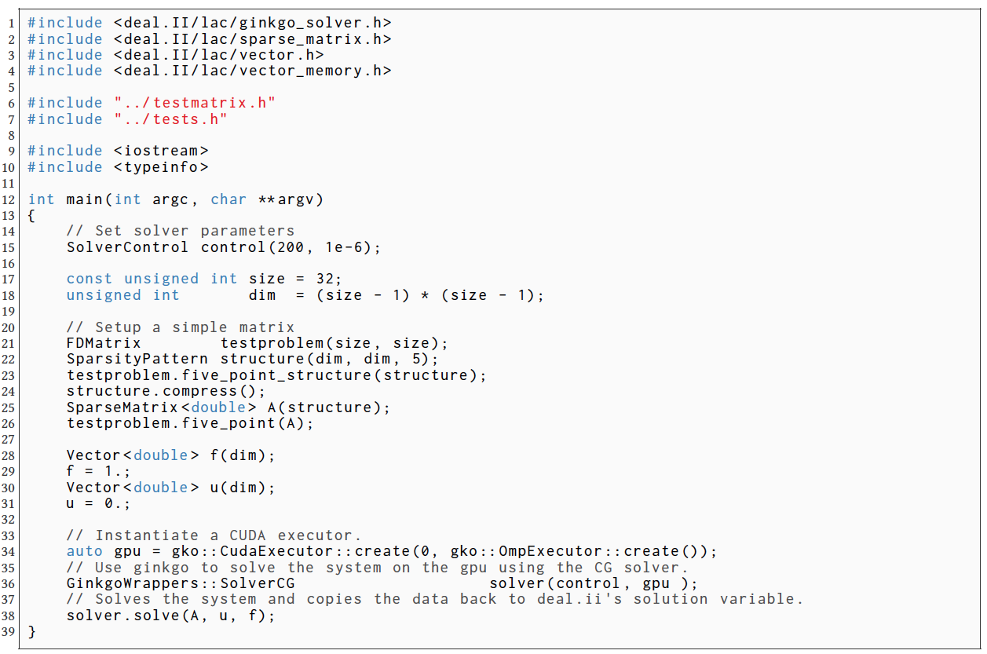
Ginkgo Functionality (version 1.1.0)
Include Ginkgo functionality
Control Ginkgo solver
Generate deal.ii problem
Generate Ginkgo executor
Generate Ginkgo solver
Solve linear system

Slide 18
Continuous Integration & Continuous Benchmarking

Slide 19
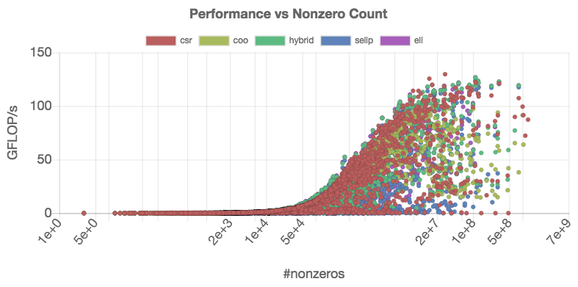
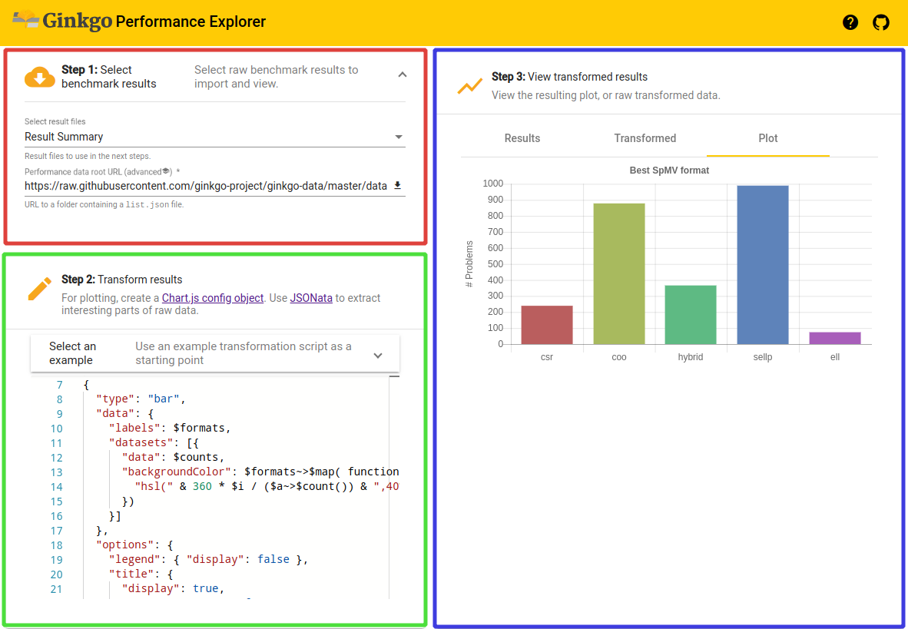
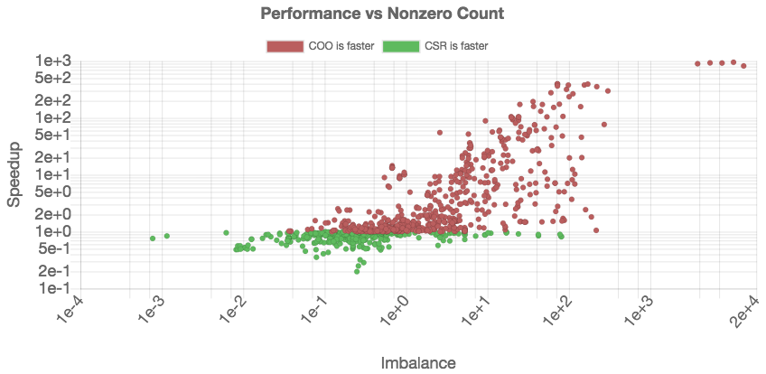

Ginkgo Performance Explorer (GPE)
Allows anyone to access & visualize Ginkgo Performance data in a browser.
https://ginkgo-project.github.io/gpe/

Slide 20
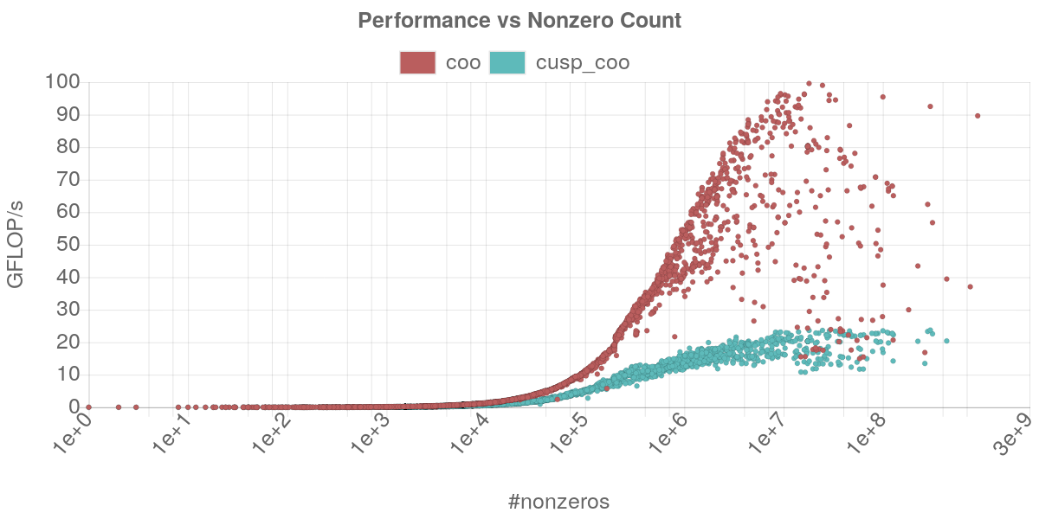
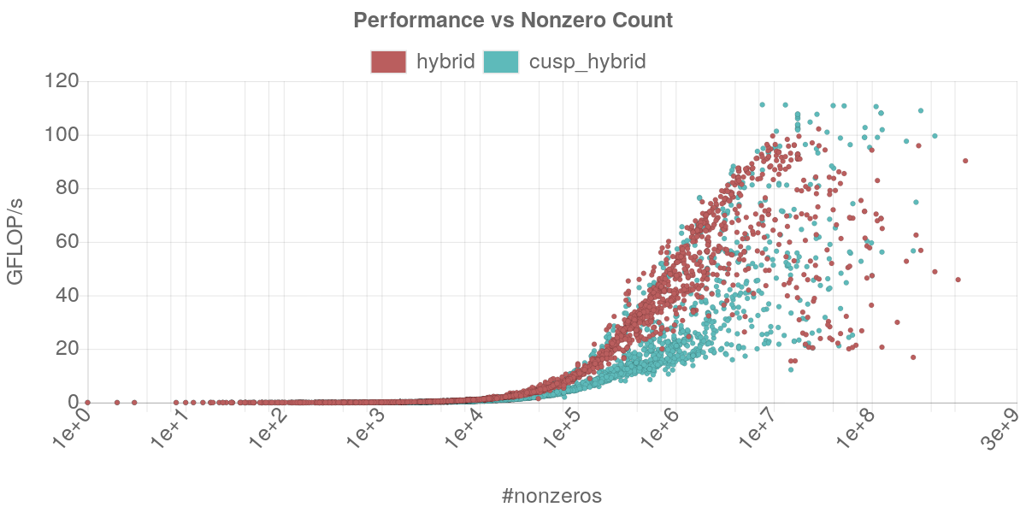
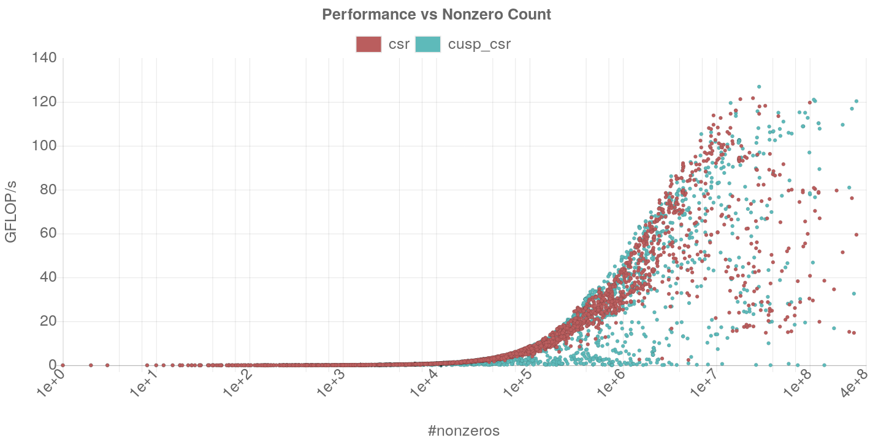
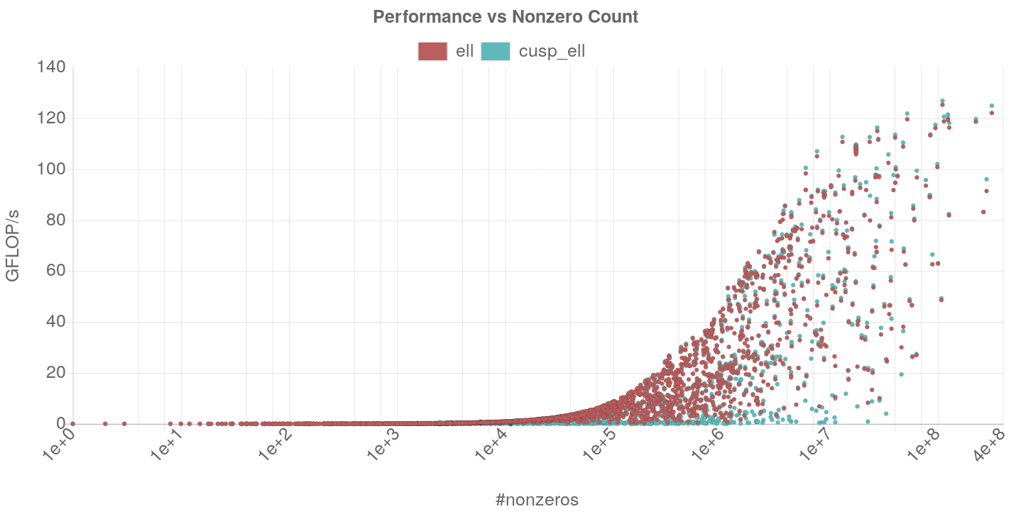
Ginkgo SpMV Performance
hybrid
COO
CSR
ELL

Slide 21
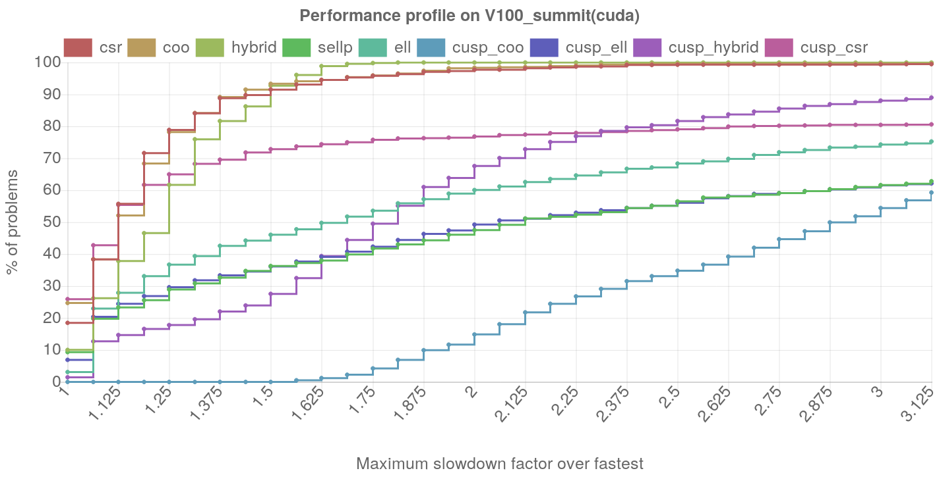
Ginkgo SpMV Performance
Anzt, Cojean, Chen, Dongarra, Flegar, Nayak, Tomov, Tsai, Wang: Load-balancing Sparse Matrix Vector Product Kernels on GPUs, TOPC, 2019.

Slide 22


Past, Present, Future…
05/2017
05/2017
10/2017
11/2017
02/2018
07/2018
09/2018
09/2018
12/2018
01/2019
05/2019
07/2019
10/2019
10/2019
11/2019
01/2020
01/2020
06/2020
06/2020
Start library design discussions
Initial C++ usage tests
"First bits in the bucket” https://github.com/ginkgo-project/ginkgo
Ginkgo name decision
Continuous Integration (CI)
Ginkgo Performance Explorer (GPE) https://ginkgo-project.github.io/gpe/
Continuous Benchmarking (CB)
deal.ii Finite Element Software integration example
Ginkgo Project Webpage https://ginkgo-project.github.io/
PAPI SDE integration
Ginkgo v.1.0.0 release
Ginkgo approved for xSDK release v.0.5.0
Ginkgo v.1.1.0 release
MFEM Finite Element Software integration example
HIP executor
PetSC integration
Trilinos integration
FEAST sparse eigensolver
Multi-GPU executor?

Slide 23

Past, Present, Future…
05/2017
05/2017
10/2017
11/2017
02/2018
07/2018
09/2018
09/2018
12/2018
01/2019
05/2019
07/2019
10/2019
10/2019
11/2019
01/2020
01/2020
06/2020
06/2020
Start library design discussions
Initial C++ usage tests
"First bits in the bucket” https://github.com/ginkgo-project/ginkgo
Ginkgo name decision
Continuous Integration (CI)
Ginkgo Performance Explorer (GPE) https://ginkgo-project.github.io/gpe/
Continuous Benchmarking (CB)
deal.ii Finite Element Software integration example
Ginkgo Project Webpage https://ginkgo-project.github.io/
PAPI SDE integration
Ginkgo v.1.0.0 release
Ginkgo approved for xSDK release v.0.5.0
Ginkgo v.1.1.0 release
MFEM Finite Element Software integration example
HIP executor
PetSC integration
Trilinos integration
FEAST sparse eigensolver
Multi-GPU executor?

